Slide 1
Data science for neutron scattering
Malcolm Guthrie, Jean Bilheux, Zach Morgan, Andrei Savici, Yuanpeng Zhang

Slide 2
What is modern scientific software?
There are many different types of software project
Some commonly found characteristics:
Open source
Multiple contributors
Dependencies on other software projects (e.g. imports in a python script)
version controlled (using git)
hosted repositories (on GitHub or GitLab)
These apply to most software projects here at ORNL

Slide 3
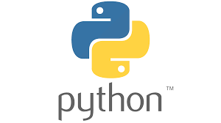
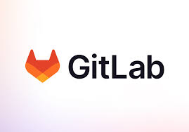



Key tools
Contributing to such code requires an awareness of several critical tools
This tutorial will introduce some of these

Slide 4
Version control and git
version control is a way to manage software which continually changes over time.
It can be viewed as enabling “snapshots” of a project to be saved.
These “snapshots” can be recovered as needed.
It’s also possible to systematically compare different “snapshots” and merge these together
git is a very popular version-control system

Slide 5
some helpful (git) terminology
repository (or “repo”)
noun
a collection of folders and or files containing data (this could be anything: source code, text files, images, mp3s etc)
branch
noun
A “snapshot” of a repo where changes can be made without modifying the original repo. Many branches can exist in parallel (like the limbs of a tree)

Slide 6
some helpful (git) terminology
master or main
noun
Default name for the first branch
merge
noun
process of combining two or more commit histories

Slide 7
What is github
github is a hosting site for git repositories owned by microsoft
extremely popular (> 372M) with many useful features for code development
For example: github.com/neutrons contains repositories for most current Neutron science directorate software projects

Slide 8
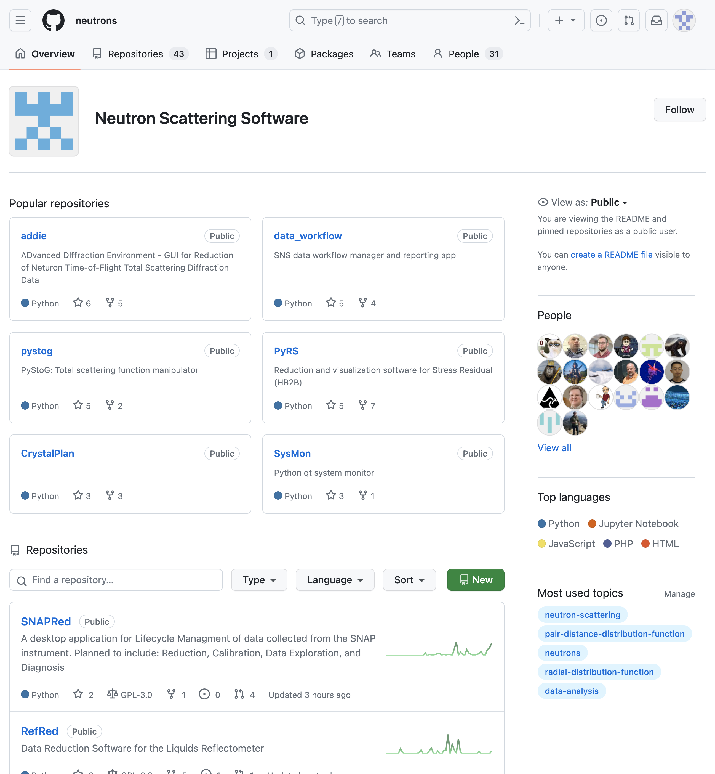

Slide 9
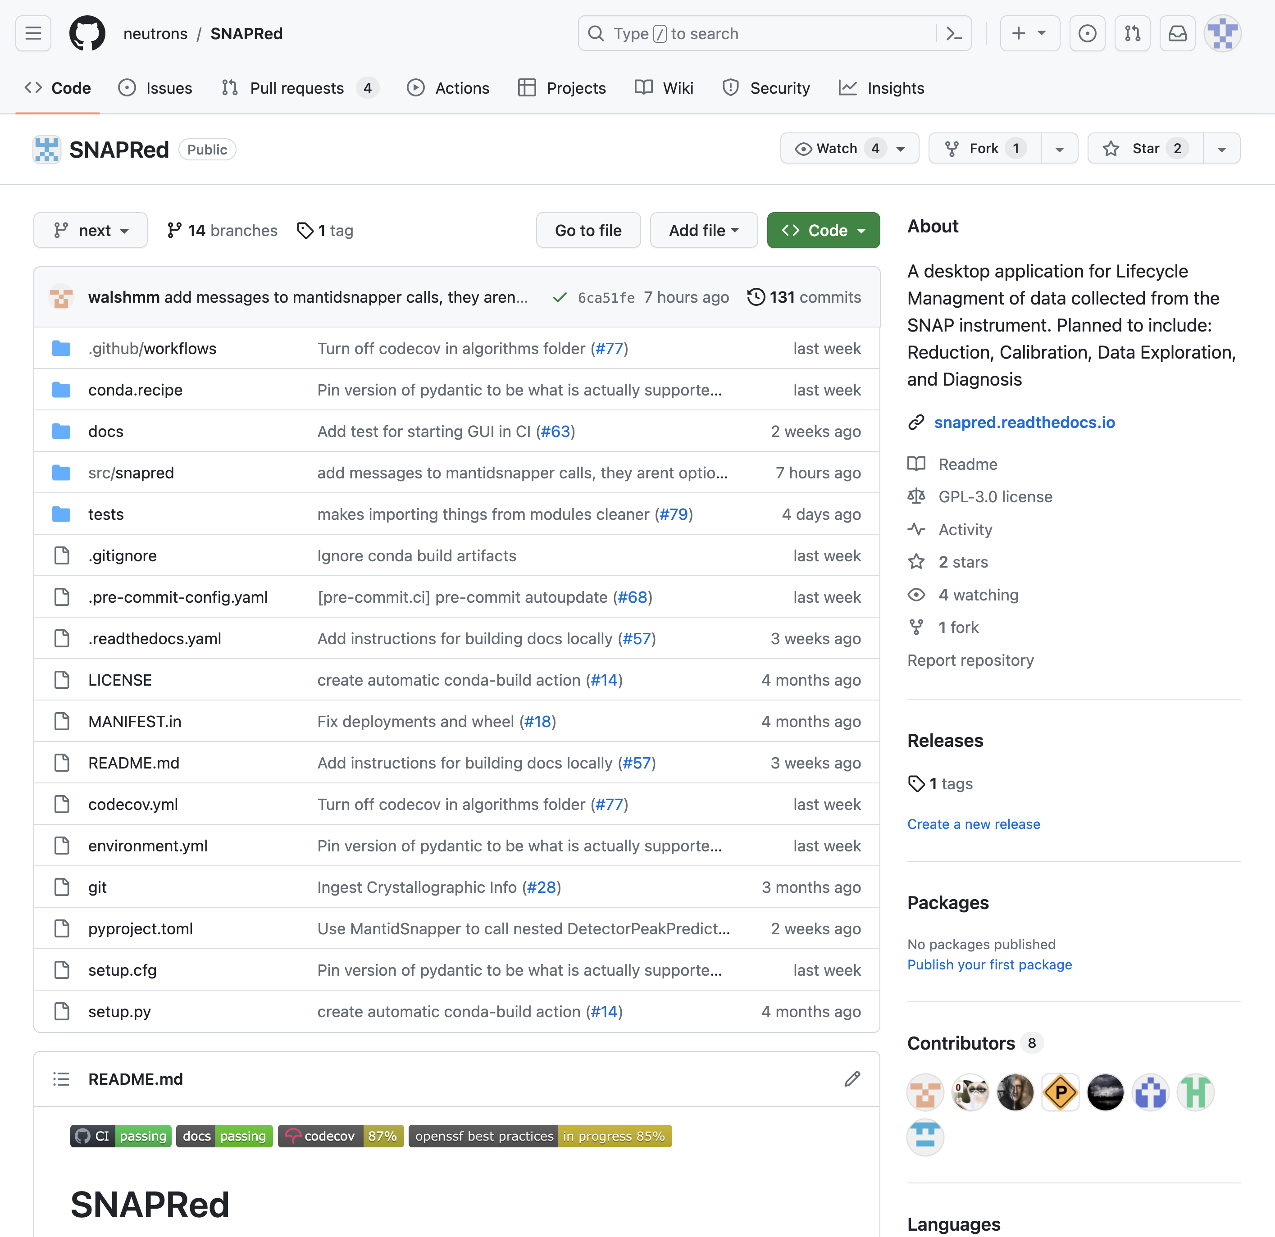
Title of repo

Slide 10
Short description
of project

Slide 11
readme contains
more detailed
information on project

Slide 12
Contents of repo
(folders and files)

Slide 13
most recent commit
messages

Slide 14
github users who have
committed to repo

Slide 15
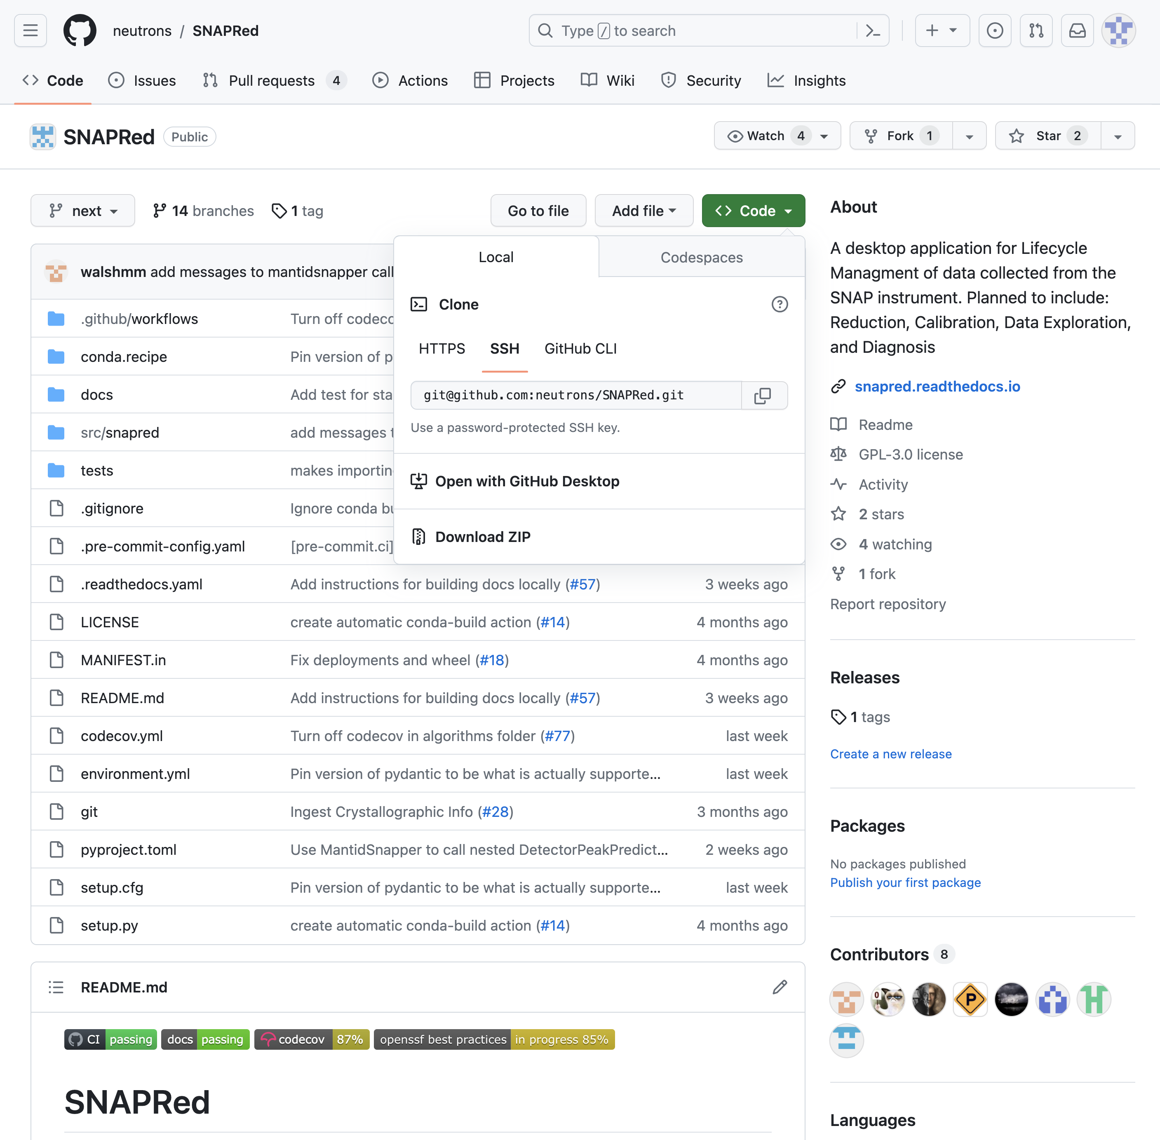
Clicking the green
“Code” button
reveals ways to
download the repo

Slide 16
Cloning a git hub repo
can be done via command line where git is installed.
in github
click code button
copy the HTTPS address (https://github.com/neutrons/SNAPRed.git)
Create a folder to put the repo, go to folder and enter:
$ git clone https://github.com/neutrons/SNAPRed.git

Slide 17
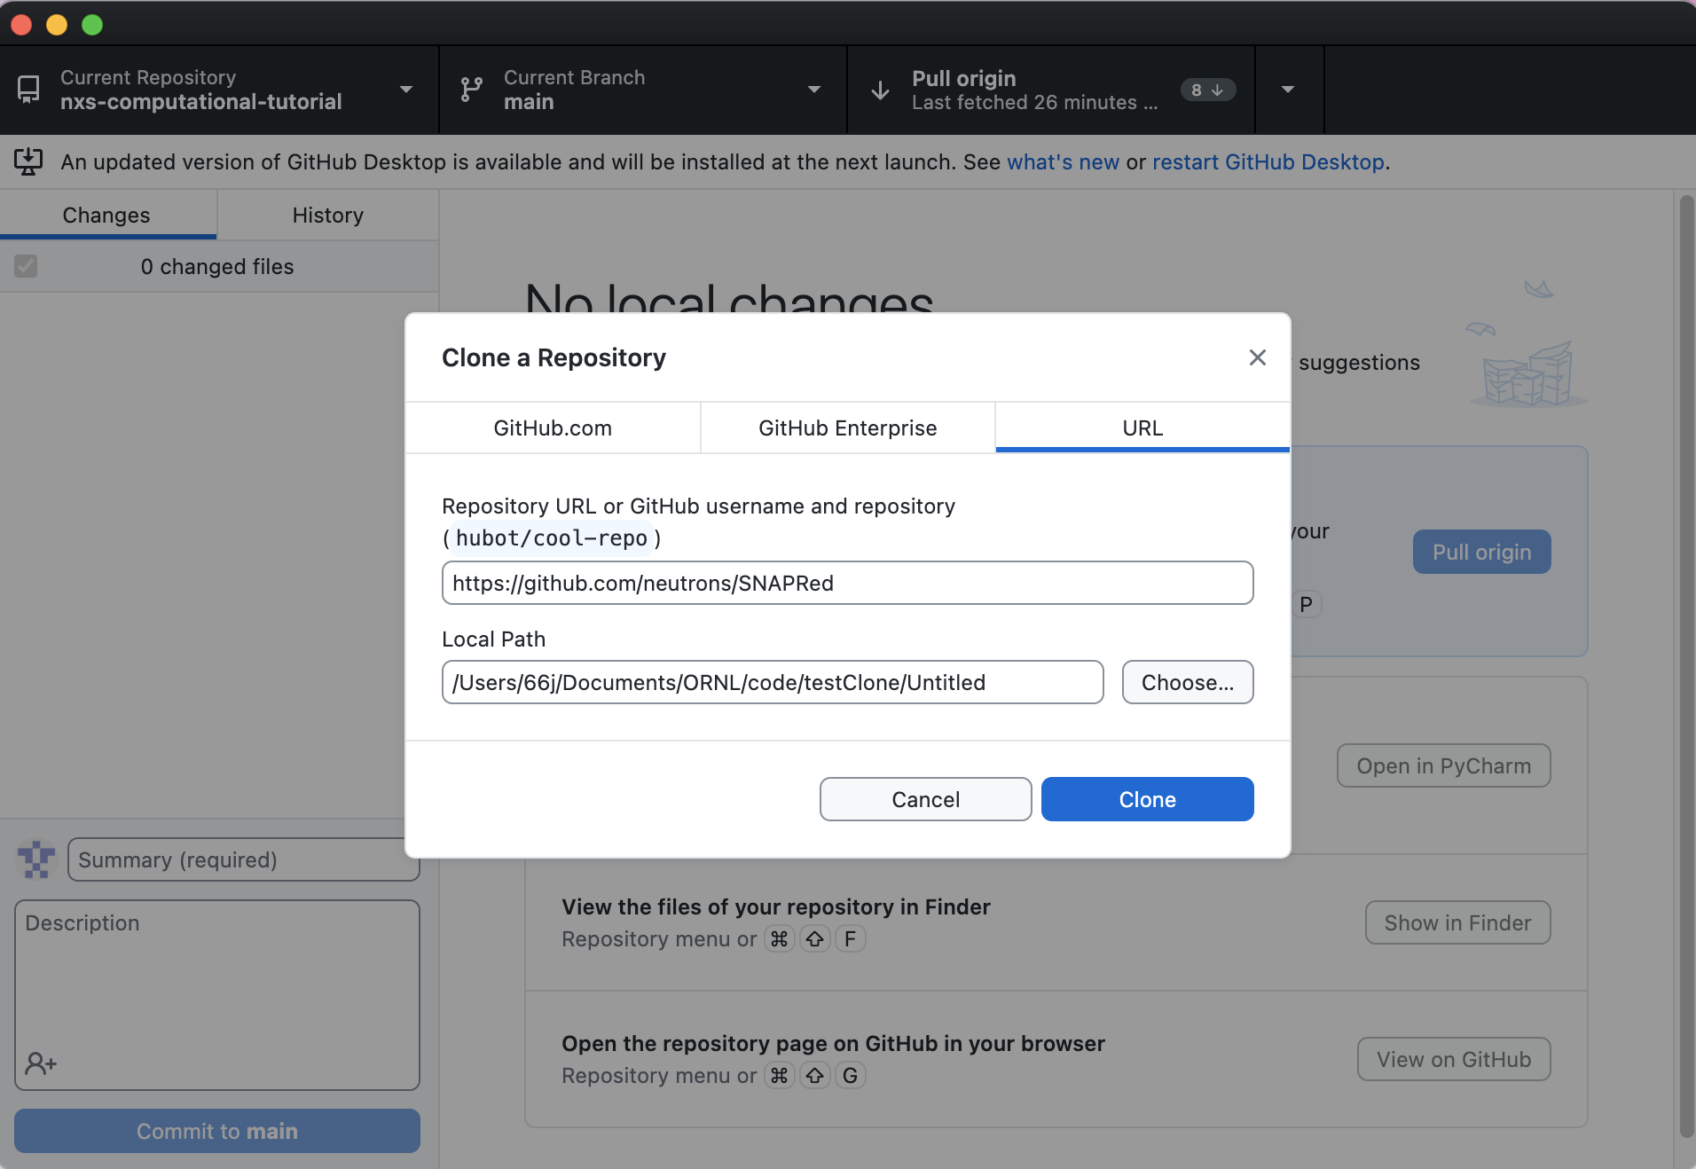
Cloning a git hub repo
Or, even easier, install the github desktop app and click open “with GitHub Desktop”

Slide 18
the “Pull Request”
Pull requests are done when a developer wants changes with they’ve committed to be merged with another branch.
GitHub allows easy code review during a pull request
Automatically compares branches and highlights changes
Allows inline commenting and acception/rejection of changes
In many repos maintain separate development branches and release branches. (mantidworkbenchnightly is the dev branch of mantidworkbench)
Pull requests made to development branch can be tested before final release.

Slide 19


Environment management
Running Python Options

Slide 20
Environment management
Why
Environment manager available: conda, mamba, pyvenv
How it works
Demo

Slide 21





Environment management Why

Slide 22
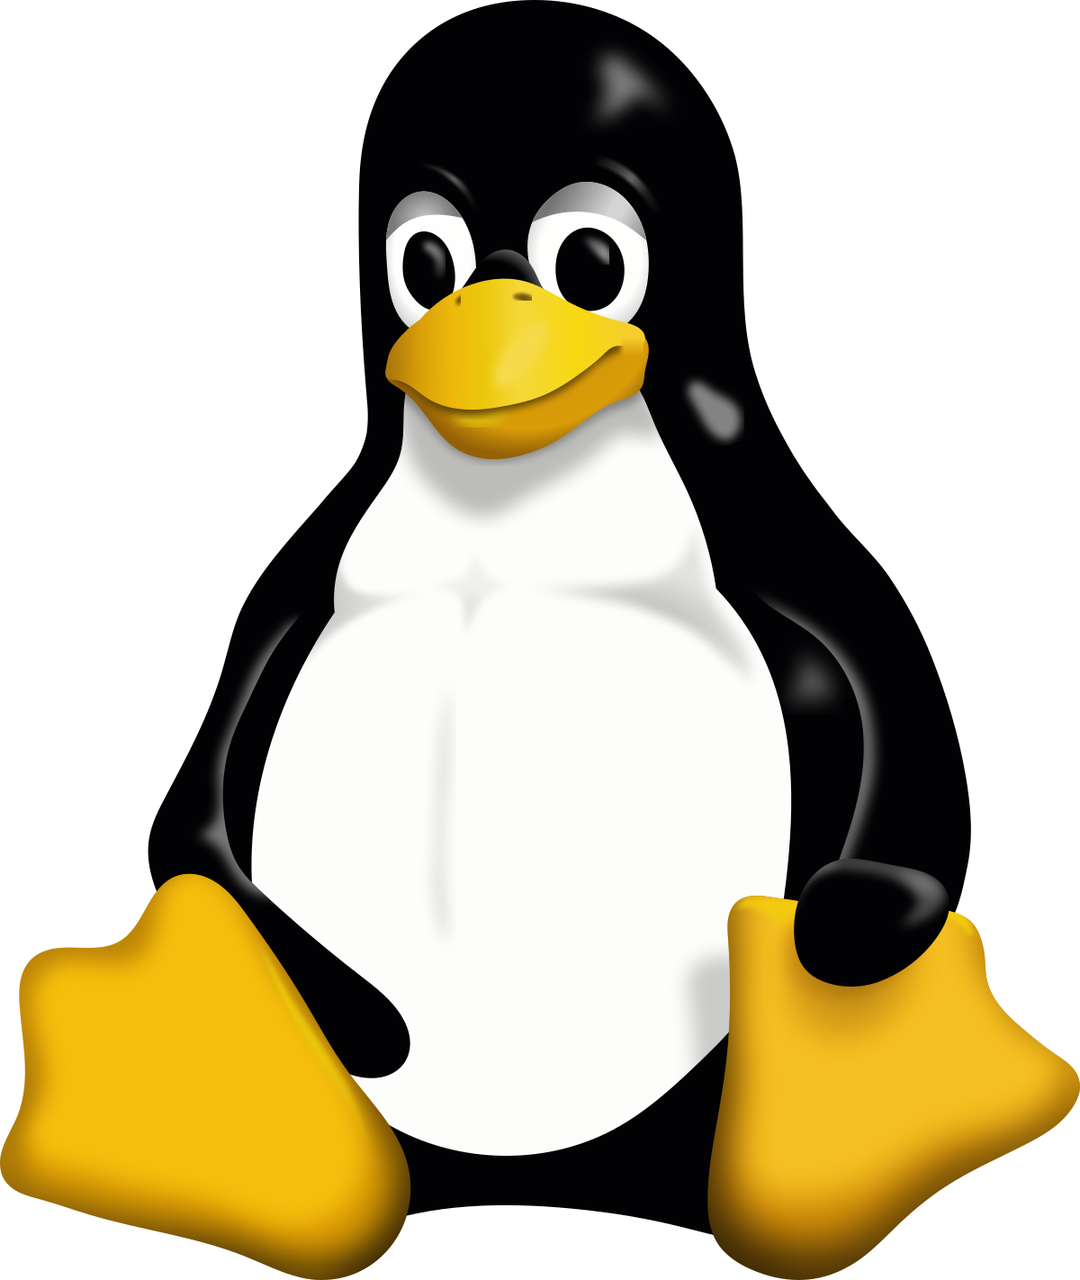


Environment management Why & How
myEnv1
Python 3.7
Matplotlib 3.7.2
Numpy 1.25.2
py310
Python 3.10
Matplotlib 3.6.0
Scipy 1.11.1
Pyqtgraph 1.13
Pandas 2.03
Qt 5.0
Environment
manager
p311
$ conda remove –name p311 --all
Python 3.11
Pandas 2.02
Qt 5.0

Slide 23
Environment management Why & How
myEnv1
Python 3.7
Matplotlib 3.7.2
Numpy 1.25.2
py310
Python 3.10
Matplotlib 3.6.0
Scipy 1.11.1
Pyqtgraph 1.13
Pandas 2.03
Qt 5.0
Environment
manager
p311
$ conda create –n env311 python=3.11 pandas=2.02 qt=5.0
Python 3.11
Pandas 2.02
Qt 5.0

Slide 24
Environment management Demo
Plan:
Create a conda environment called py38 that has the following requirements:
Python 3.8
Matplotlib (latest version)
Numpy (latest version)
Activate the environment
Install jupyter
Let’s jump to a terminal …

Slide 25
Environment management basic commands
$ conda env list
$ conda activate <environment name>
$ conda deactivate <environment name>
$ conda remove –n <environment name> --all

Slide 26
Running python options
Python terminal (iTerm, warp …)
Ipython
Notebook (anaconda navigator, jupyter lab, jupyter notebook)
Editor + command line (emacs, brackets, Atoms, …)
IDE (PyCharm, Visual Studio, Eclipse, …)

Slide 27
Running python options
Python terminal (iTerm, warp …) – to try a command
Ipython – to try a command
Notebook (anaconda navigator, jupyter lab, jupyter notebook)
to test a routine, to play with data, to give a script to others, to learn python
Editor + command line (emacs, brackets, Atoms, …)
to create batch scripts
IDE (PyCharm, Visual Studio, Eclipse, …)
to implement long term-use programs, to create libraries

Slide 28
Where to find data at SNS/HFIR?

Slide 29
What is data?
Raw data
Collection of neutron scattering events (time of flight, wallclock time, sample log, detector positions, …)
Usually saved in a hdf5 format using a NeXus format (*.nxs.h5)
Reduced data
Transformed data into something that has some physical meaning or some intermediate format that other programs used by the community can understand
Can be ASCII/ NeXus hdf5/ image/any other format

Slide 30
Where are my files?
Home folder – only you have access by default
/SNS/users/<username>
Raw data file
Organized by instrument and proposal
/SNS/<instrument>/IPTS-<12345>/nexus
/SNS/users/<username>/data/SNS/<instrument>/IPTS-<12345>/nexus
Instrument files
/SNS/<instrument>/shared
Reduced data files
/SNS/<instrument>/IPTS-<12345>/shared
/SNS/<instrument>/IPTS-<12345>/shared/autoreduce

Slide 31
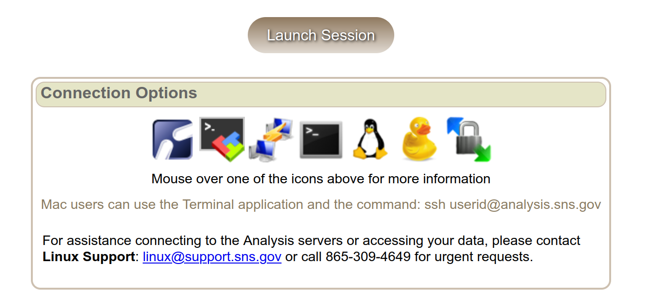
How to get the data?
Secure file transfer protocol
From a terminal sftp or scp
GUIs for Windows, MacOS
https://analysis.sns.gov/

Slide 32
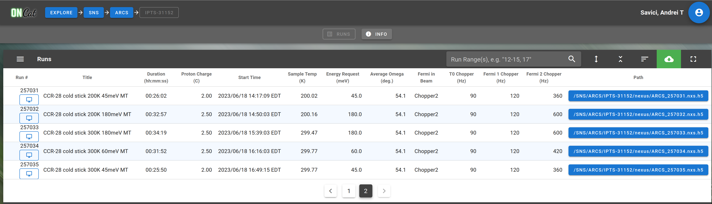
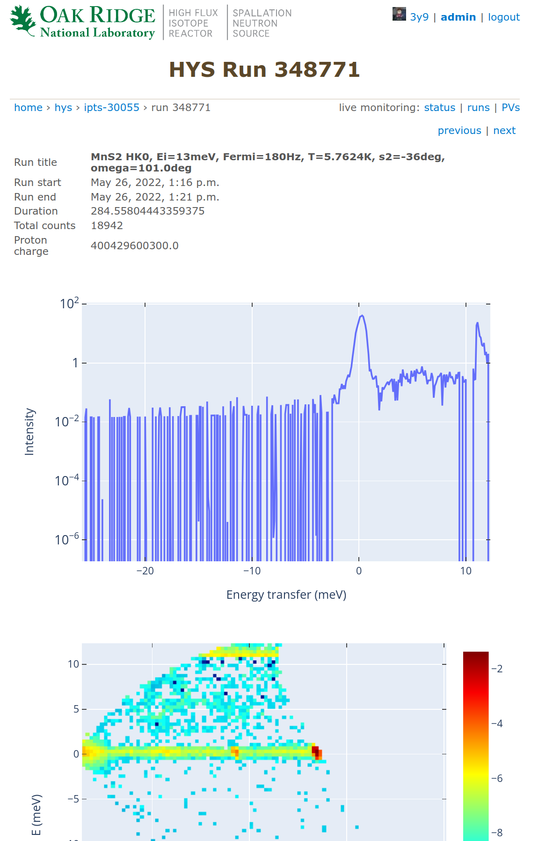
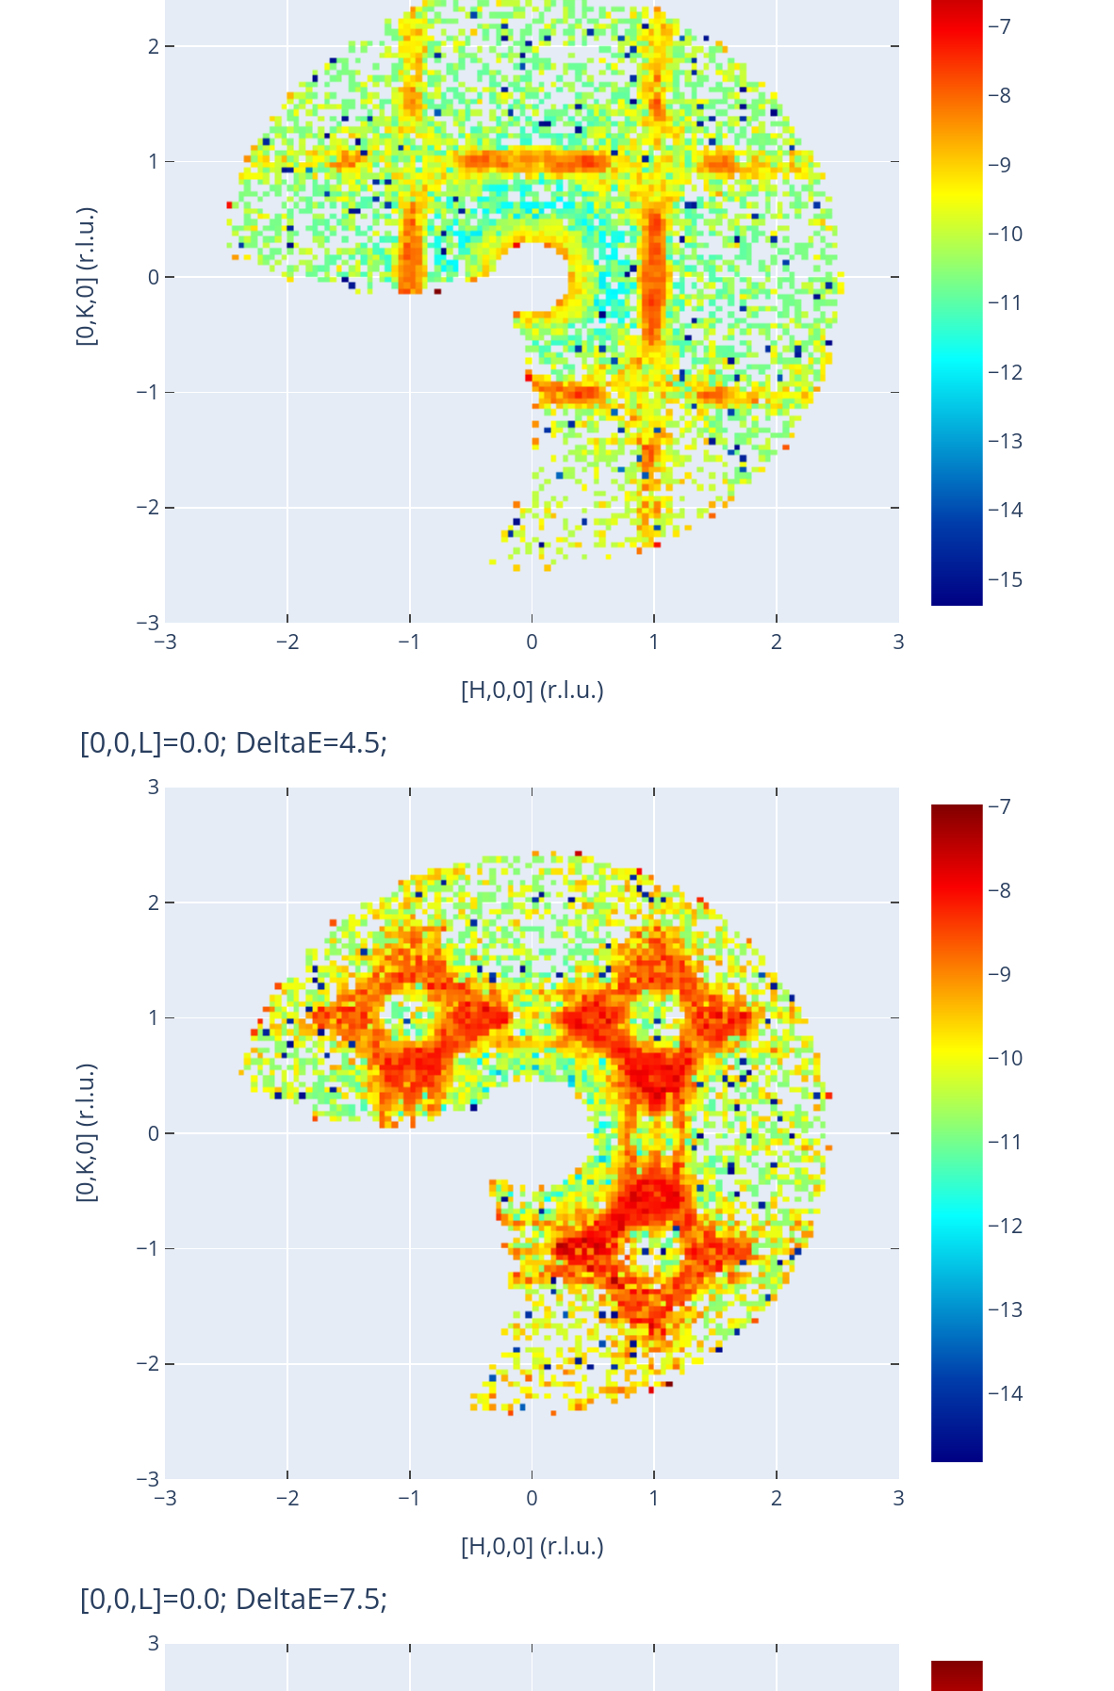
Organize and track data
https://oncat.ornl.gov
https://monitor.sns.gov

